Slide 1
A Method for Evaluating System Robustness in Stochastic, High-Dimensional, Multi-Failure Mode Models
Edward Louis, Gregory Mocko, Evan Taylor
DISTRIBUTION STATEMENT A. Approved for public release; distribution is unlimited. OPSEC10928

Slide 2
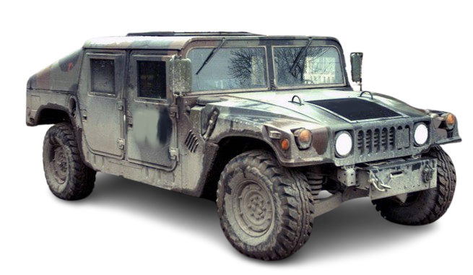
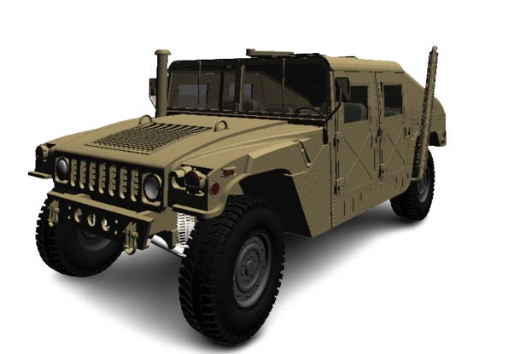
Motivation
US Army Digital Thread¹
MBSE adoption²
Next-Generation US Army ground vehicles³:
    Advanced powertrain technology
    Off-road autonomy
    Human-Machine Integrated Formations (HMIF)
1. DoD Instruction, 2022
2. Gorsich et al, 2019
3. B. Kempinski and C. Murphy, 2012
1

Slide 3
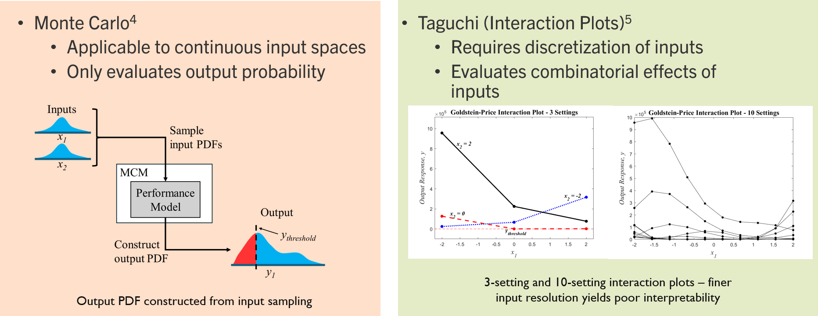
Robust Design 2
Need for high-performing systems AND robustness to inherent variance
Existing methods for evaluating performance loss due to variance
4. D. Padmanabhan et al, 2006 5. R. Splechtna et al, 2015
2

Slide 4
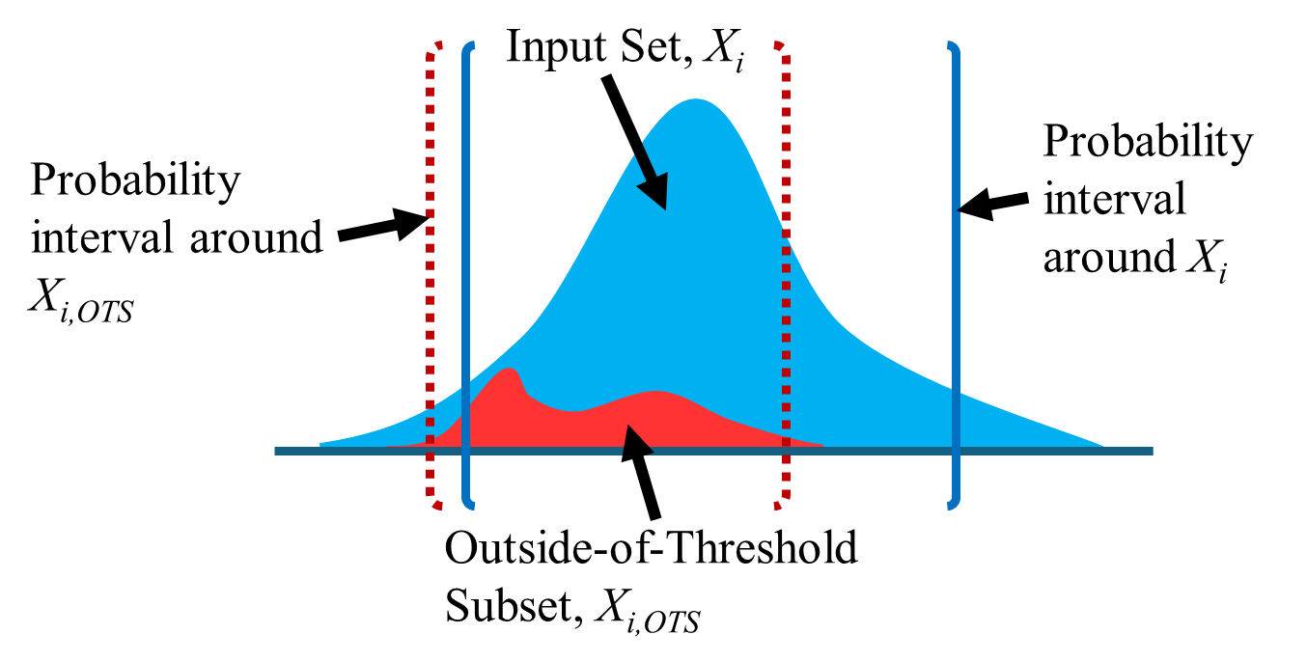
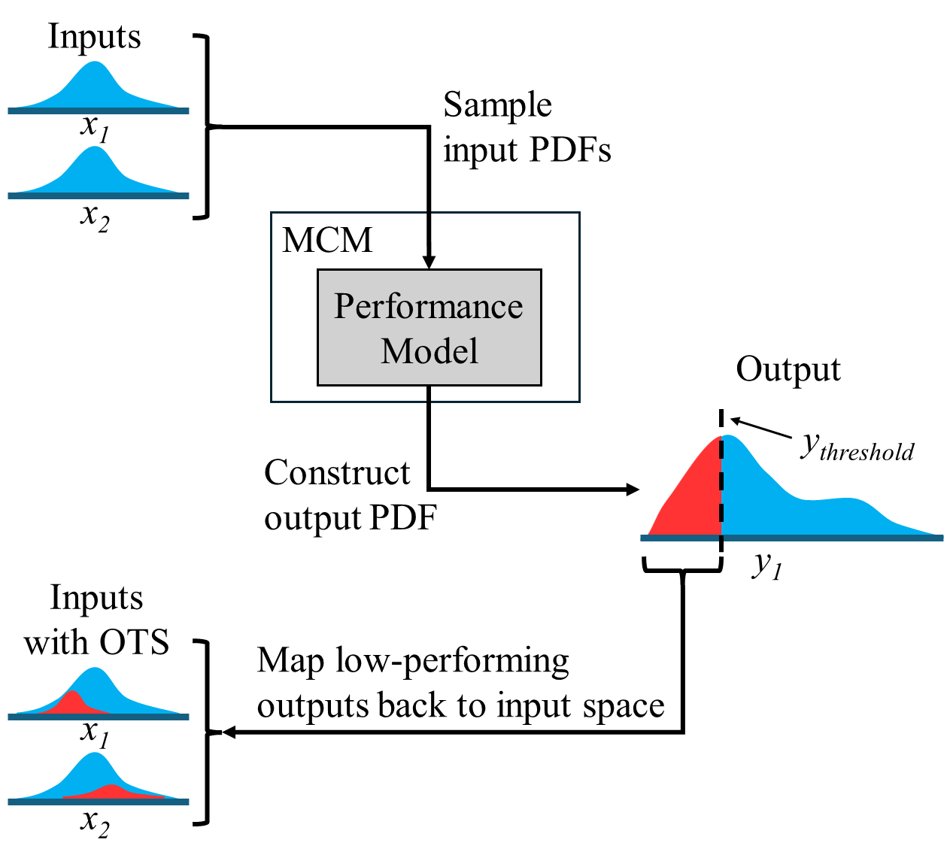
Stochastic Robustness Evaluation and Categorization
Store and index all inputs and outputs
Use indices to find all y < y_{threshold}
Find indices of all inputs that yield y < y_{threshold}
Construct Out-of-Threshold Set (OTS) for each input
Construct probability interval around input PDF and OTS PDF
Categorize each input space into four regions
Evaluate OTS probability of each region
3

Slide 5
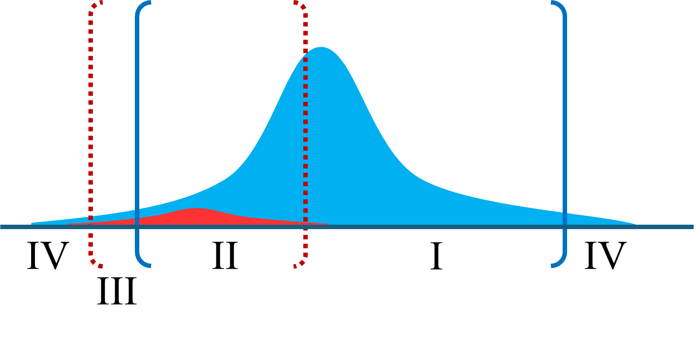
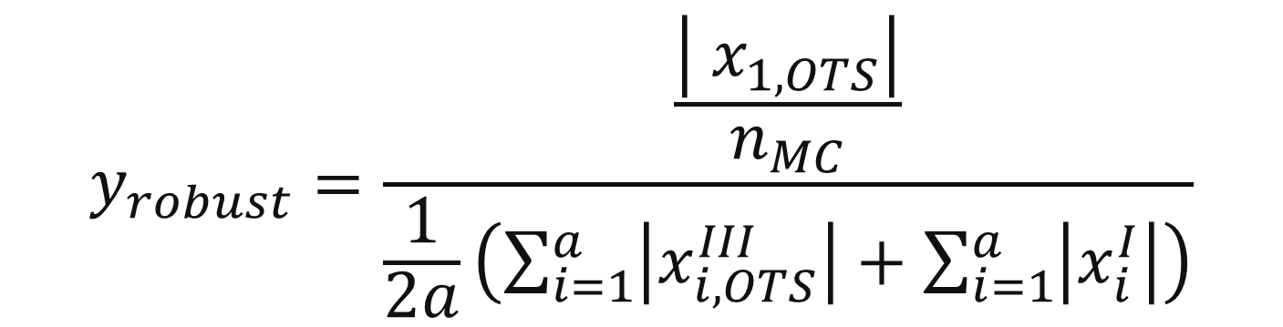
Categorization and Robustness Evaluation
Input PDF categorized into 4 regions
  Based on probability intervals
Quantify robustness
  Construct objective functions using categorization and probabilities
Regions
Region I: High prob. of point occurring, low prob. of failure
Region II: High prob. of point occurring, high prob. of failure
Region III: Low prob. of point occurring, high prob. of failure
Region IV: Low prob. of point occurring, low prob. of failure
Regions identified from OTS construction and probability intervals
$$y_{robust}=\frac{\frac{\left|{ x}_{1,OTS}\right|}{n_{MC}}}{\frac{1}{2a}\left(\sum_{i=1}^{a}{\left|x_{i,OTS}^{III}\right|}+\sum_{i=1}^{a}{\left|x_{i}^{I}\right|}\right)}$$
Robustness objective function rewards OTS clustered far away from input PDF mode and small OTS size relative to input
4

Slide 6
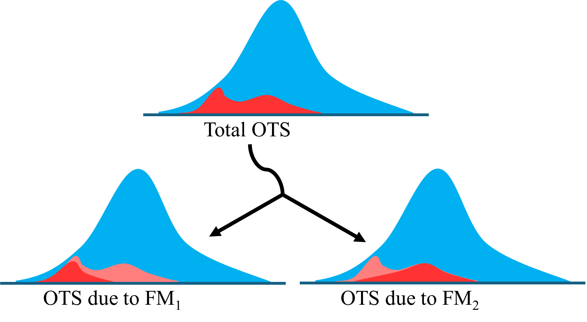
Multi Failure Mode Models
Multiple physical phenomena can limit performance of systems
Multi-failure mode (FM) models consider multiple limiting phenomena
5

Slide 7
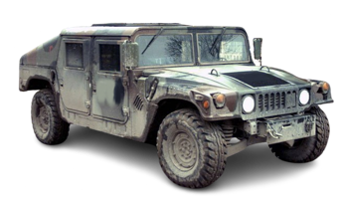

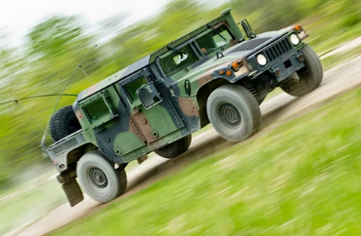
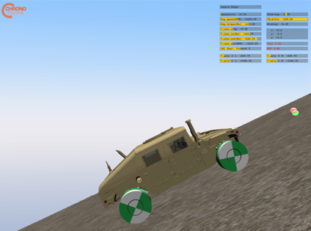
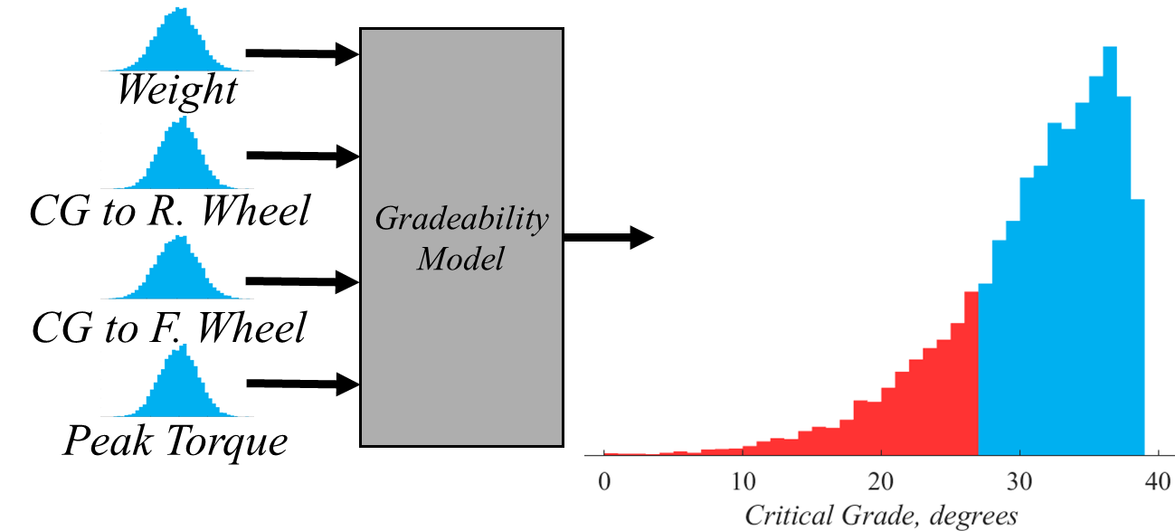
Multi-FM Gradeability Model
HMMWV ascending longitudinal grade
  US Army TOP 02-2-610 gradeability testing scenario
Model with 3 FMs
  Tip-over
  Traction loss
  Insufficient torque
Design Variable | Mean | Standard Deviation
Vehicle Weight [N] | 60,000 N | 5,000 N
CG to R. Wheel Distance [m] | 1.8 m | 1 m
CG to F. Wheel Distance [m] | 1.5 m | 0.5 m
Peak Motor Torque [Nm] | 515 Nm | 150 Nm
6

Slide 8
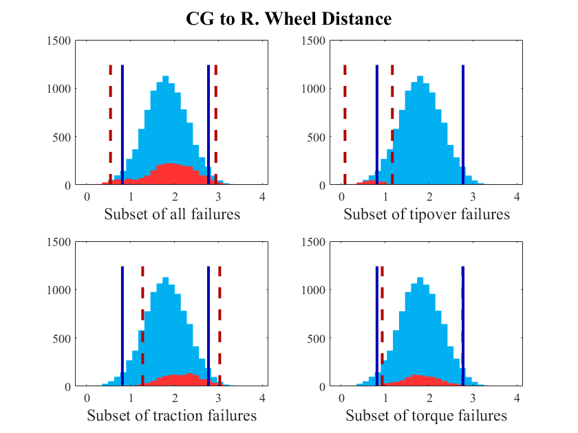
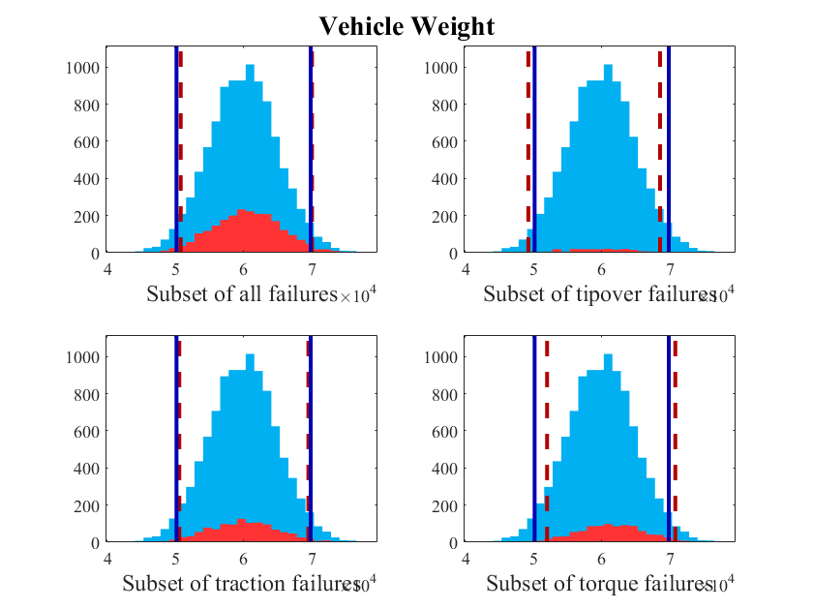
Gradeability SREC Results
SREC evaluates which inputs are impactful on a failure mode
Evaluates which failure modes are more likely to occur given input mean
  CG to rear wheel distance has strong impact on tipover failure, smaller impact on traction
Evaluates which inputs are impactful on a performance objective
The selected nominal vehicle weight value corresponds to many failures
7

Slide 9
Gradeability SREC Results (cont)
Probability tables for CG to rear wheel distance
 | Reg. II | Reg. III | Reg. IV
Input Proportion | 95.0% | 3.4% | 1.6%
OTS Proportion | 20.1% | 1.8% | 1.2%
OT Likelihood | 21.2% | 53.8% | 72.3%
Probability table for all gradeability failure modes for CG to rear wheel distance input
 | Reg. I | Reg. II | Reg. III | Reg. IV
Input Proportion | 88.2% | 6.8% | 2.4% | 2.5%
OTS Proportion | 0.1% | 0.6% | 1.5% | 0.0%
OT Likelihood | 0.1% | 8.4% | 59.4% | 1.6%
Probability table for tip-over failures for CG to rear wheel distance input.
8

Slide 10


Conclusion and Future Work
The failure mode affects shape of failing distributions and output distribution
  Extends to individual failure modes (ex: subset of tip-over failures, subset of traction failures, etc)
Design space exploration
  How do “classes” of vehicle fare against different failure modes?
    Ex: different powertrain technologies, different suspension types
  Tradespace exploration (multi-objective optimization)
Compare models of dissimilar ground vehicles
  Wheeled and tracked vehicles require different models
Modeling additional failure modes
  How to extend models to consider rare “edge case” failures
Find ways to reduce cost
  MC is already a slow algorithm
  This method adds 2m function calls on top of MC sim
  Stores 2nm additional variables (2n variables per MC run)
9

Slide 11
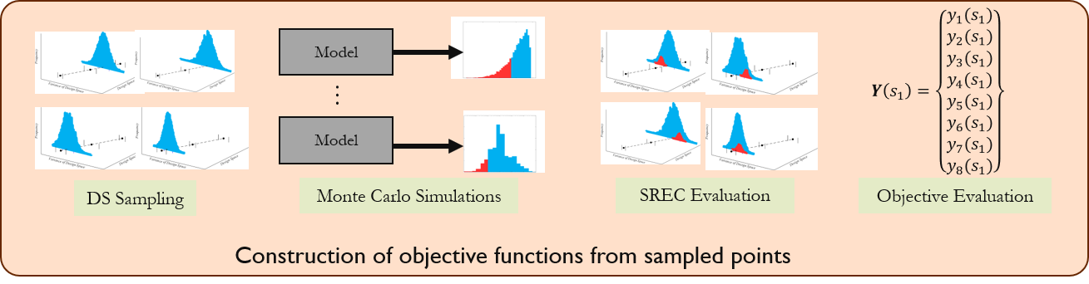
Multi-Objective GV Design with SREC
8 objectives based on Gradeability and Dash Speed US Army TOP documents
  Stochastic model evaluates robustness to several failure modes
4 design variables
5000 solutions generated using SREC
Find solutions using multi-objective optimization techniques (Pareto relaxation and preference filtering
Four test cases
  2 levels of fidelity
  2 operational focuses
Off-road oriented vehicle
  Gradeability performance and robustness
On-road oriented vehicle
  Acceleration performance and robustness
High fidelity: 7 objective problem
Low fidelity: 3 objective problem
10

Slide 12
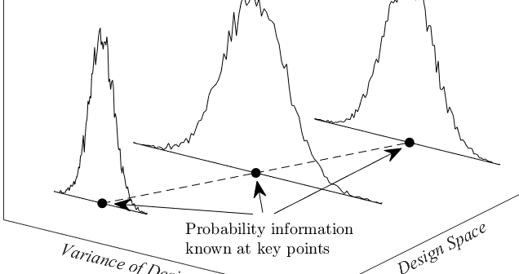
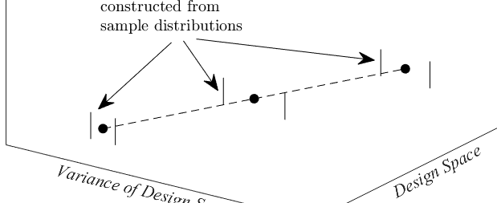
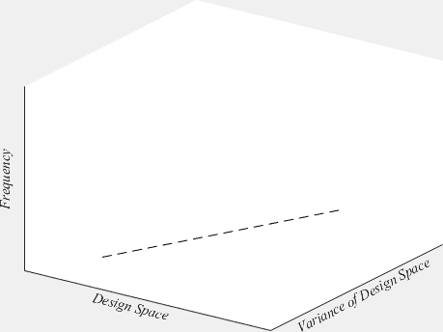
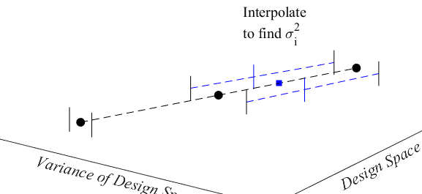
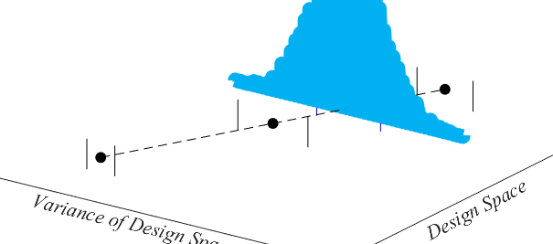
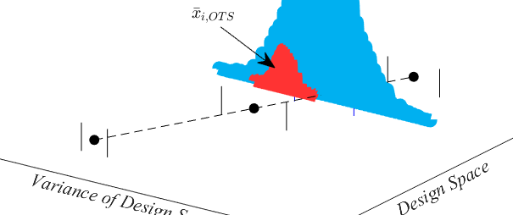
Stochastic Design Space Exploration
Populating the design space (DS) with SREC
Supports use of SREC in multi-objective design studies
Each point in DS is categorized according to FM robustness
Prior knowledge of DS variance
Generate σ² from prior knowledge
Construct input PDF and apply SREC at sampled point
Sample a point, interpolate to find sample’s σ²
Populate DS with repeated application of SREC
11

Slide 13
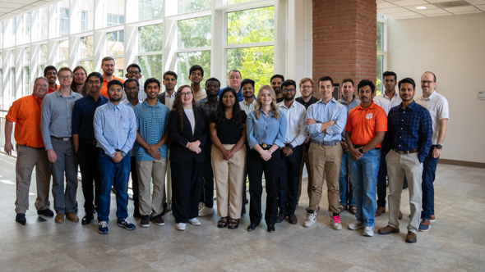
Acknowledgements
This work was supported by Clemson University’s Virtual Prototyping of Autonomy Enabled Ground Systems (VIPR-GS) under Cooperative Agreement W56HZV-21-2-0001 with the US Army DEVCOM Ground Vehicle Systems Center (GVSC).
All opinions, conclusions and findings wherein are those of the authors and may not be those of the affiliated institutions.
Thank you to my colleagues in the CEDAR Lab at Clemson!
12

Slide 14
Next-gen ground vehicle systems must be both high performing and robust to failure modes
High-dimensional, mixed uncertainty models make understanding input-output relationship difficult
Construction of sets and categorization of solutions falling into these sets can be used for multi-objective tradespace exploration studies in systems design
13

Slide 15
References
[1] “DoD Instruction 5000.87: Operation of the Software Acquisition Pathway.”
[2] D. Gorsich, R. Gerth, S. Bradley, and M. Letherwood, “An Overview of the Next-Generation NATO Reference Mobility Model (NG-NRMM) Cooperative Demonstration of Technology (CDT),” in NDIA Ground Vehicle Systems Engineering and Technology, Novi: NDIA, Aug. 2019, pp. 1–10.
[3] B. Kempinski and C. Murphy, “Technical Challenges of the U.S. Army’s Ground Combat Vehicle Program,” Congressional Budget Office, 2012–15, Nov. 2012.
[4] D. Padmanabhan, H. Agarwal, J. E. Renaud, and S. M. Batill, “A study using Monte Carlo Simulation for failure probability calculation in Reliability-Based Optimization,” Optim. Eng., vol. 7, no. 3, pp. 297–316, Sept. 2006, doi: 10.1007/s11081-006-9973-8.
[5] R. Splechtna, M. Elshehaly, D. Gračanin, M. Ɖuras, K. Bühler, and K. Matković, “Interactive interaction plot: Supporting parameter space exploration in a design phase,” Vis. Comput., vol. 31, no. 6–8, pp. 1055–1065, June 2015, doi: 10.1007/s00371-015-1095-x.
14

